Slide 1

B.E. Major Project on
H. J. Thim Trust’s
Theem College of Engineering, Boisar
Boisar Chilhar Road, Boisar (E), Palghar
DEPARTMENT OF INFORMATION TECHNOLOGY
Prevention of drowning incidents in swimming pool based on
automated vision based surveillance system
AVINASH SINGH (203167 )
ANKIT TRIPATHI (193109 )
RAJAN VISHWAKARMA (173128)
Guide: Prof. SHARIQUE AHMED

Slide 2
Contents
Introduction
Motivation
Problem Statement
Objectives
Scope
Review of Existing Literature
Proposed System
Block diagram of Proposed System
Implementation
Algorithm/Flowchart
Dataset
Pseudo code
Screenshots of the output with description
Technologies Used
Results and Discussion
Conclusion and Future Work
References

Slide 3
Introduction
As per the WHO, drowning is the leading cause of unintentional deaths in the world,around 372,000 drowning deaths reported annually.To overcome this problem the surveillance IoT model will help to avoid maximum cases.
These devices and objects will generate large amounts of data that can be utilized to provide a better solution and enhance both the efficiency and sustainability.
To fully automate a smart monitoring system without human involvement, computer vision techniques, which allow machines to see and understand the world through image capturing and processing, should be utilized and implemented.

Slide 4
Review of Existing Literature
Sr. No. | Paper Title [Ref.] | Author names | Conclusion | Research Gaps
1 | Automated Vision-based Surveillance System to Detect Drowning Incidents in Swimming Pools | Abdel Ilah N. Alshbatat, Shamsa Almazrouei, Wadhha Almarar
2
3
4
5
6
7
8

Slide 5
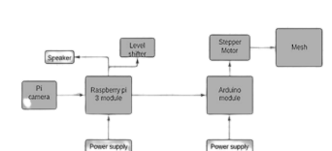
Proposed System
Fig. 1: Block diagram of the proposed system

Slide 6
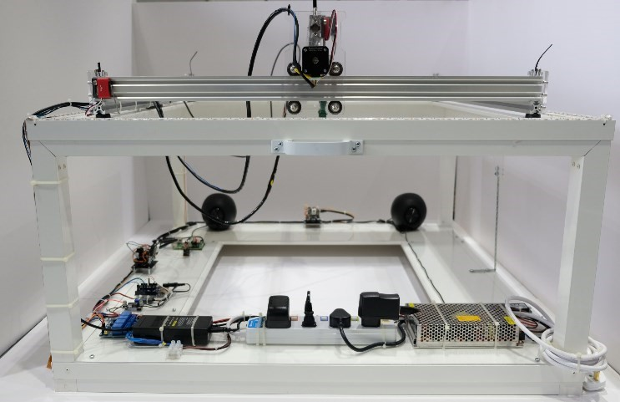
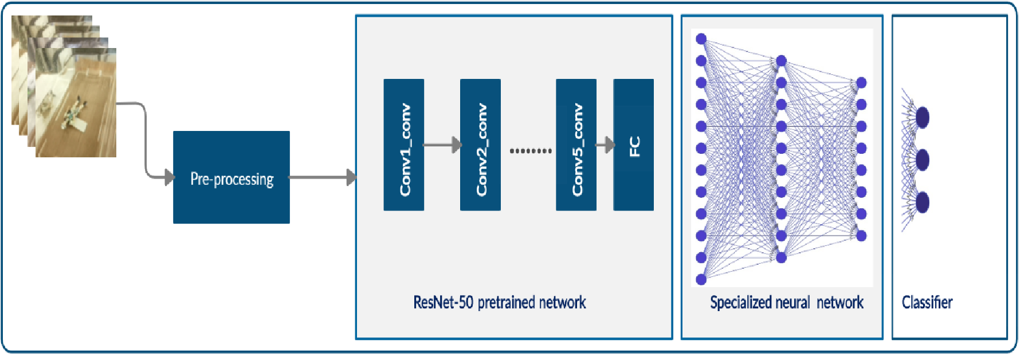
Implementation
.
Proposed Implemented System
Flow-chart

Slide 7
Technologies Used
Table 1. Hardware and software used in the prototype experiment.
Hardware | Software
Motion detection sensor | Transfer learning
Camera sensor | Deep learning
Raspberry Pi 4 | TensorFlow tool
Arduino Nano | Keras library
Stepper motor | Visual Studio
Level Shifter | Arduino Software (IDE)
Buzzer

Slide 8
Results and Discussion
When someone drowns in the swimming pool , the model will detect the actions of the victim and as per the training given from thousands of images and the water level predictions , it will alert the surrounding with the help of buzzer by producing loud sound.
By implementing the proposed system , it will prevent the unconsciousness of a person in swimming pool and also it will create a wonderful and safe experience for an individual or non swimmer to enter the swimming pool without any hesitation.

Slide 9
Conclusion and Future Work
Drowning incidents are increasing and are considered the third leading cause of unintentional injury and death. Several researches have explored and utilized IoT technologies, to prevent drowning incidents. This paper proposes an efficient and reliable system that utilizes IoT technologies and transfer learning, to prevent the occurrence of these incidents.
A specialized deep learning model was proposed and developed, utilizing only a single image to detect and classify the drowning object into three categories: human, animal, and object. This system has the ability to process and notify a swimming-pool owner through a mobile application, to overcome off-time surveillance drowning incident.
Warning message will signal the life guard of imminent danger. With such systems, the number of drownings would be reduced. For future development, the system is currently being improved by attaching an infrared LED to the swimmer’s vest.

Slide 10
References
[1] W. Lu, Y. Tan, Y. Peng, “A Vision-Based Approach to Early Detection of Drowning Incidents in Swimming Pools,” IEEE Transactions on Circuits and Systems for Video Technology 14:2 (2004):159 –178.
[2]. S. Nagalikitha, A. Kiranmai, “Automatic Waist Airbag Drowning Prevention System Based on Motion Information Measured by Memos Accelerometer and Pressure,” International Journal of Emerging Trends in Engineering Research (IJETER) 3:6 (2015): 204-206.
[3]. Thermal Imaging based off-time swimming pool surveillance System
Author:Wai Kit Wong,Joe How Hui,Chu Kiong Luu,Way soong lim
[4]. Methods and Systems for Drowning Detection Author: World Intellectual Property Organization International Bureau
[5]. Design of a Drowning Rescue Alert System Author:Samuel Ndueso John, Ukpabio Imelda Godswill,
Omoruyi Osemwegie, Godfrey Onyiagha, Etinosa Noma- Osaghae, and Kennedy Okopujie
[6]. Borrero, J.D.; Zabalo, A. An Autonomous Wireless Device for Real-Time Monitoring of Water Needs. Sensors 2020, 20, 2078.

Slide 11
Thank You !!!

Slide 12
Q & A

